Slide 1
Greco-Persian Wars

Slide 2
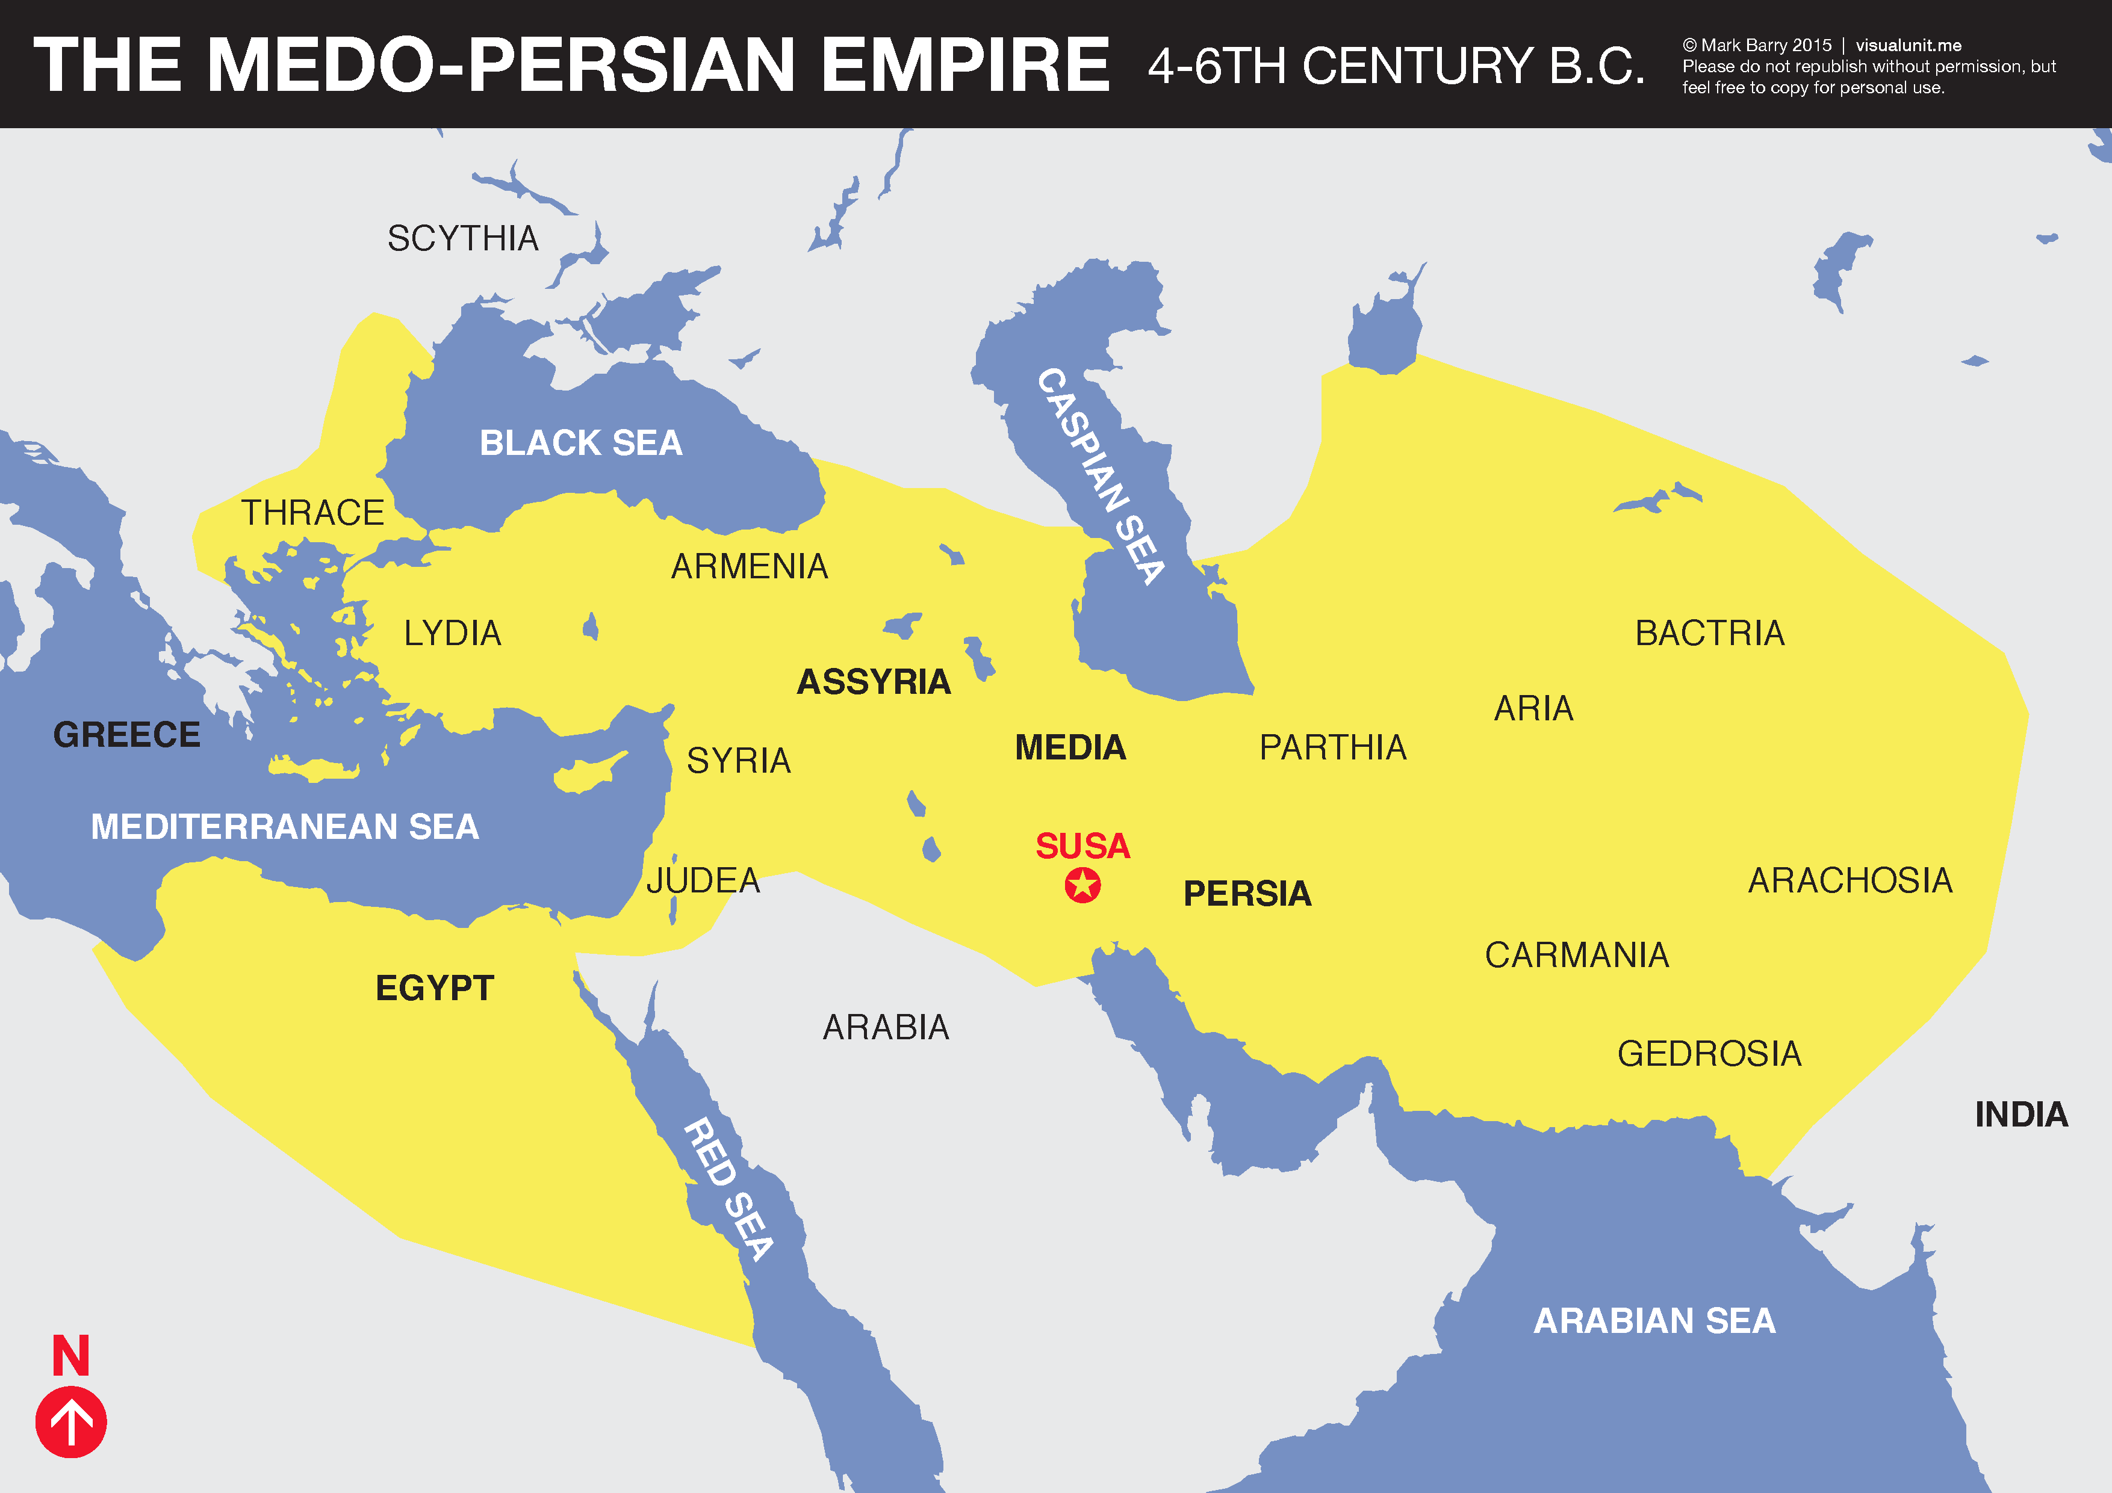
Why would an empire like Persia want to conquer Greece?

Slide 3
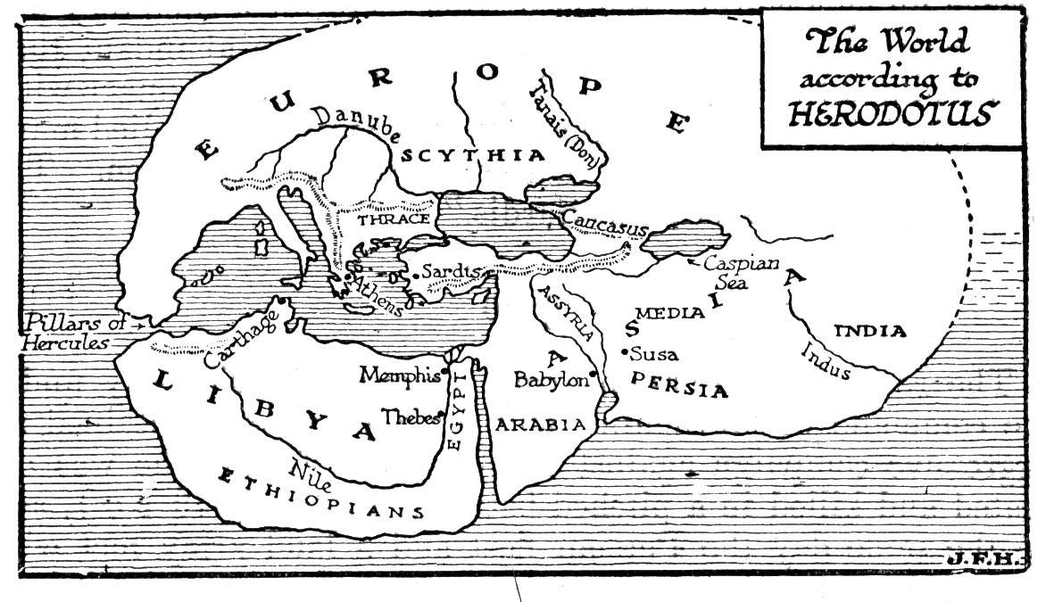
Why would an empire like Persia want to conquer a place like Greece?

Slide 4
The Following images are from the film 300 about the battle of Thermopylae during the Greco-Persian Wars.

Slide 5
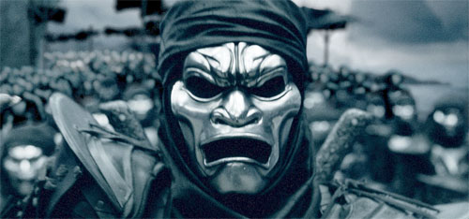
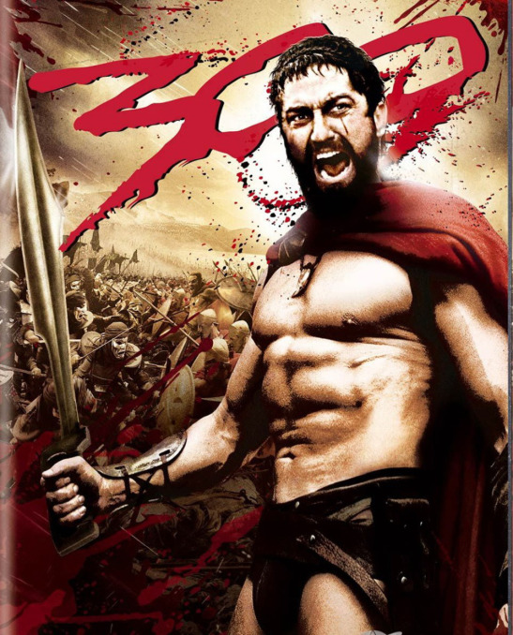
Write down words or phrases that come to mind when you look at these images. Do the images reveal differences in how Greeks and Persians are portrayed in the film? Why do you think that is so?

Slide 6
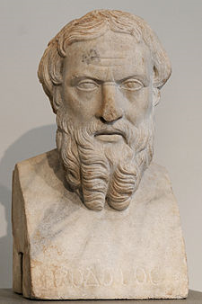
Herodotus
484-425 BCE
“Father of History”
Born in Halicarnnasus (presnt-day Turkey)
“The Histories”, comprehensive book about the Greco-Persian Wars
Pro-Greek
Focused on the WHY of history
Included gossip, myth, and exaggeration in his accounts

Slide 7
Herodotus
"No one is so foolish as to prefer war to peace: in peace children bury their fathers, while in war fathers bury their children."

Slide 8
“Historia (Inquiry); so that the actions of people will not fade with time.”
“If a man insisted always on being serious, and never allowed himself a bit of fun and relaxation, he would go mad or become unstable without knowing it.”

Slide 9
The Persians Directions
Number paragraphs 1-8
Read your assigned paragraph silently
Circle or highlight vocabulary that you don’t know. Please write words and a short definition on the paper provided.
Discuss as a group the main idea of your paragraph.
Write 2 sentences about what the main idea is on the other
paper provided. Sentences cannot begin with articles
(a, an, the) or pronouns (it, he, she, they, etc.)
Pick 1 student in each group to present sentences.
Another student will present vocabulary. Students in their seats should write definition of words in margins of reading (p. 5-6) while they are being presented.

Slide 10
What led the once nomadic Persians to
eventually settle permanently in Iran?
What made Cyrus a good ruler?
Ultimately, how did the Persian Empire
come to an end?

Slide 11
Why would an empire like Persia want to conquer Greece?

Slide 12
Historical Bias
As we read p. 271 together,
jot down in your notebook at least
2 examples of historical bias that you
see in the reading.

Slide 13
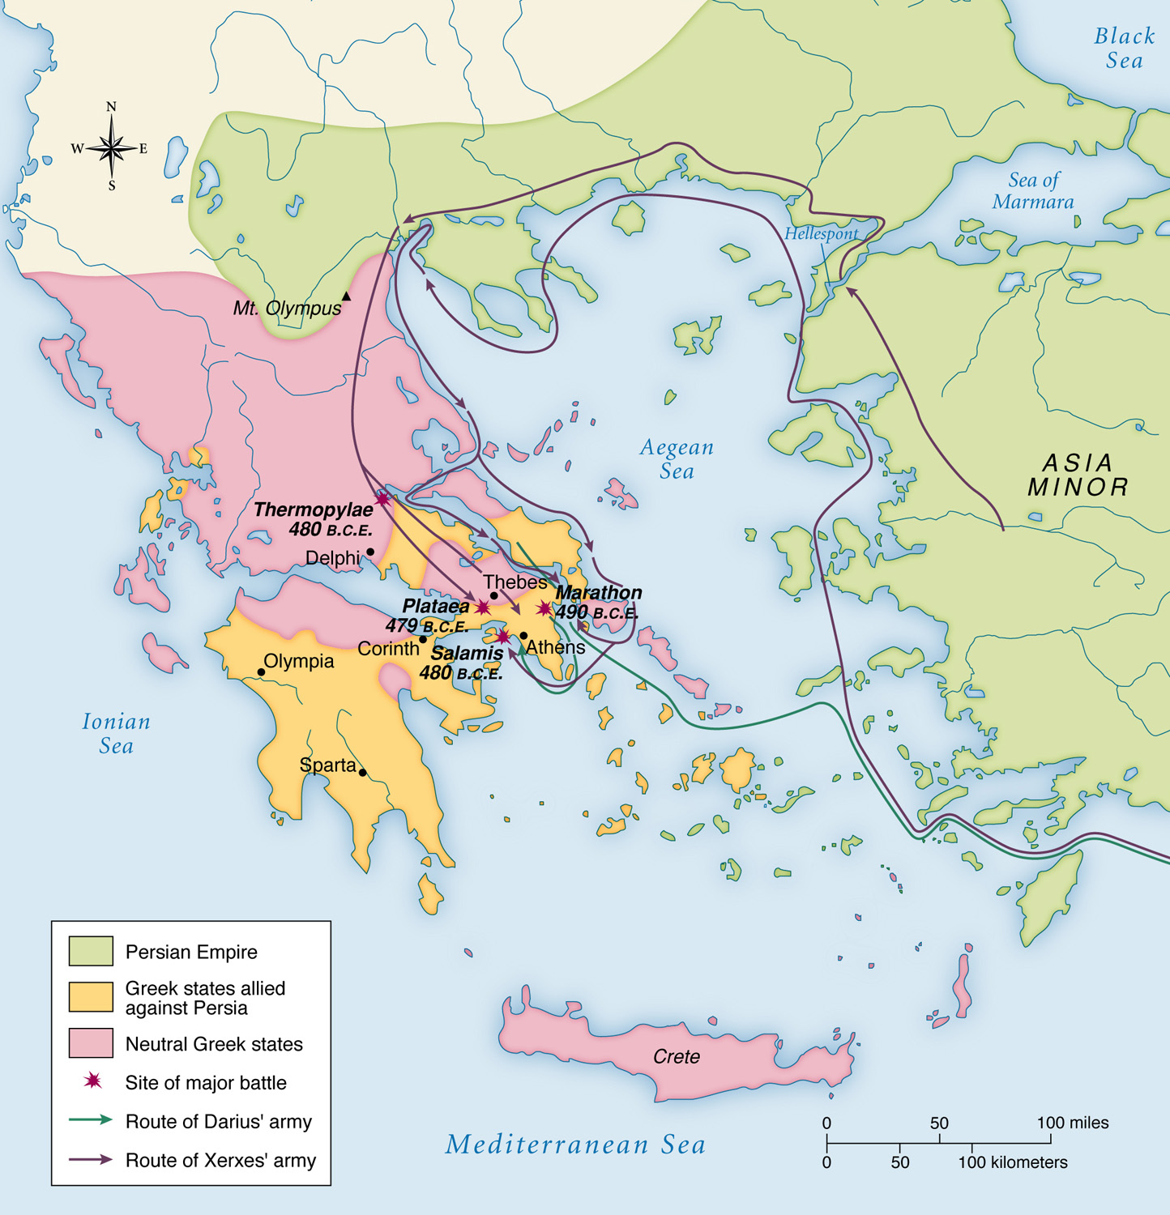

Slide 14
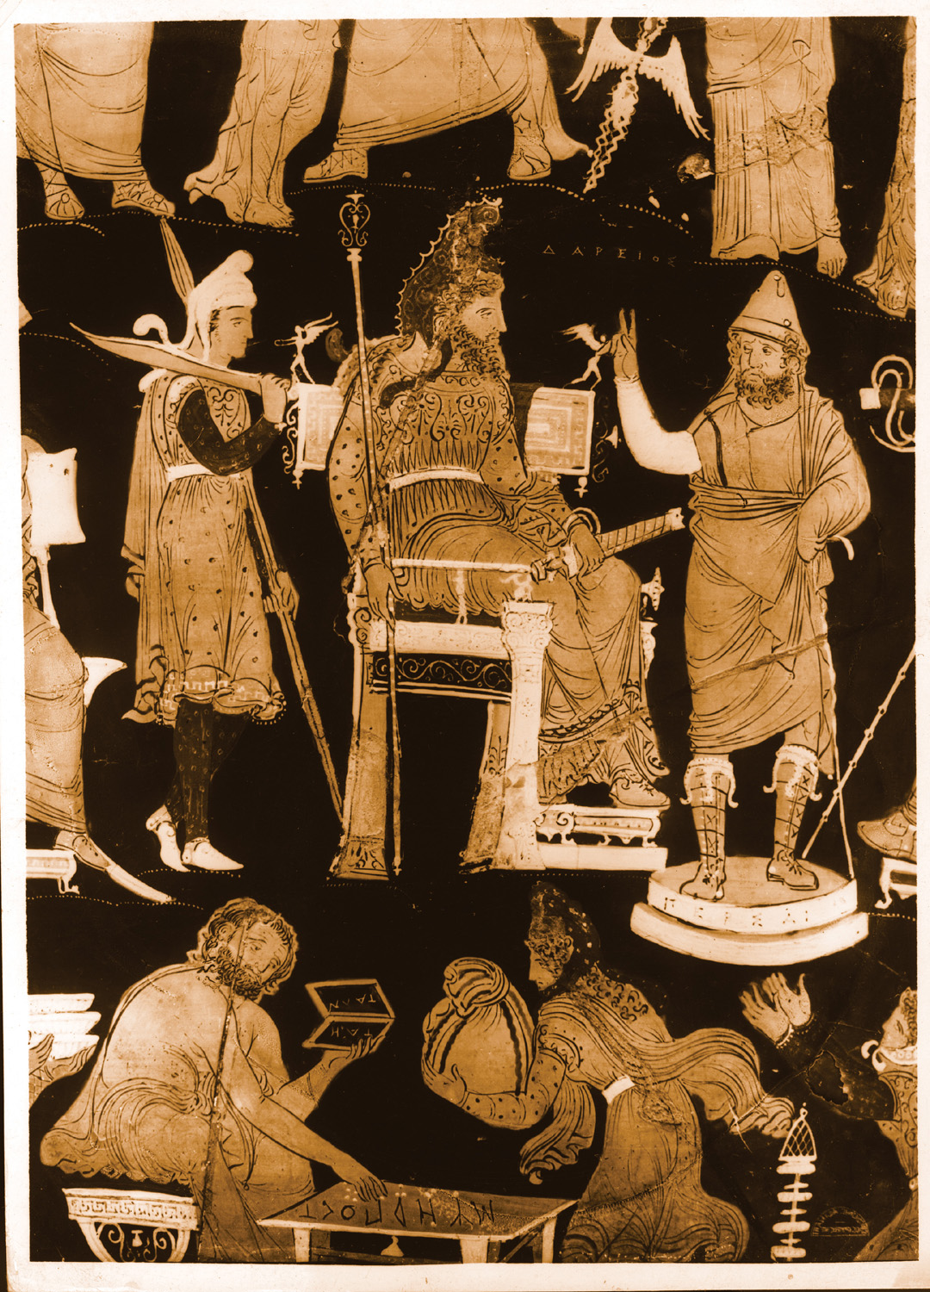

Slide 15
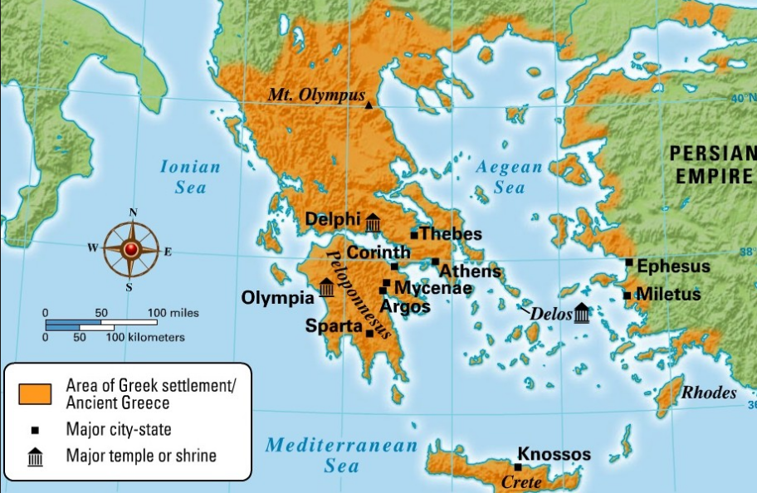

Slide 17
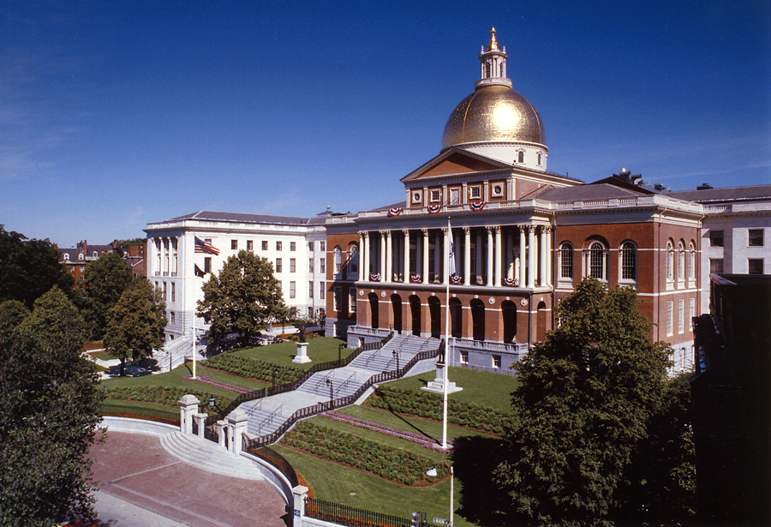

Slide 18
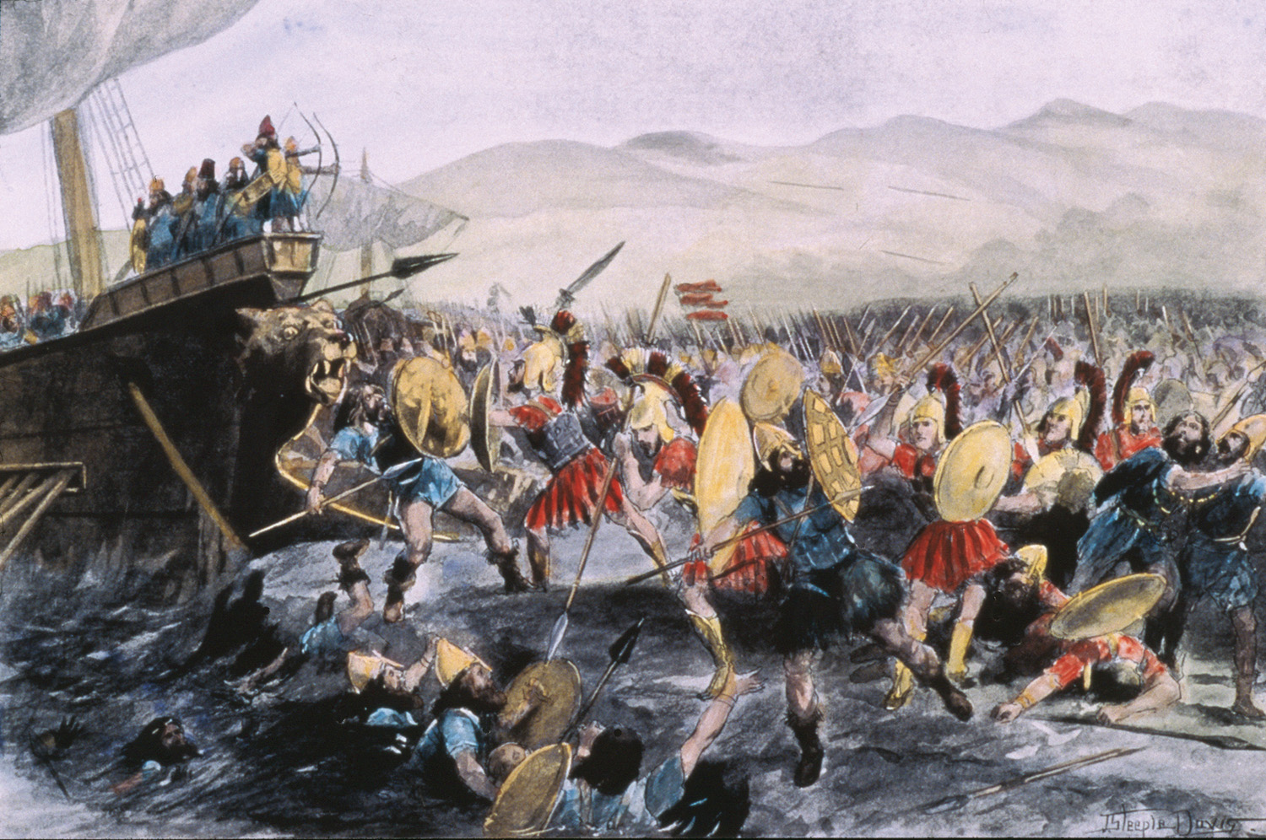
Battle of Marathon- 490 BCE

Slide 21
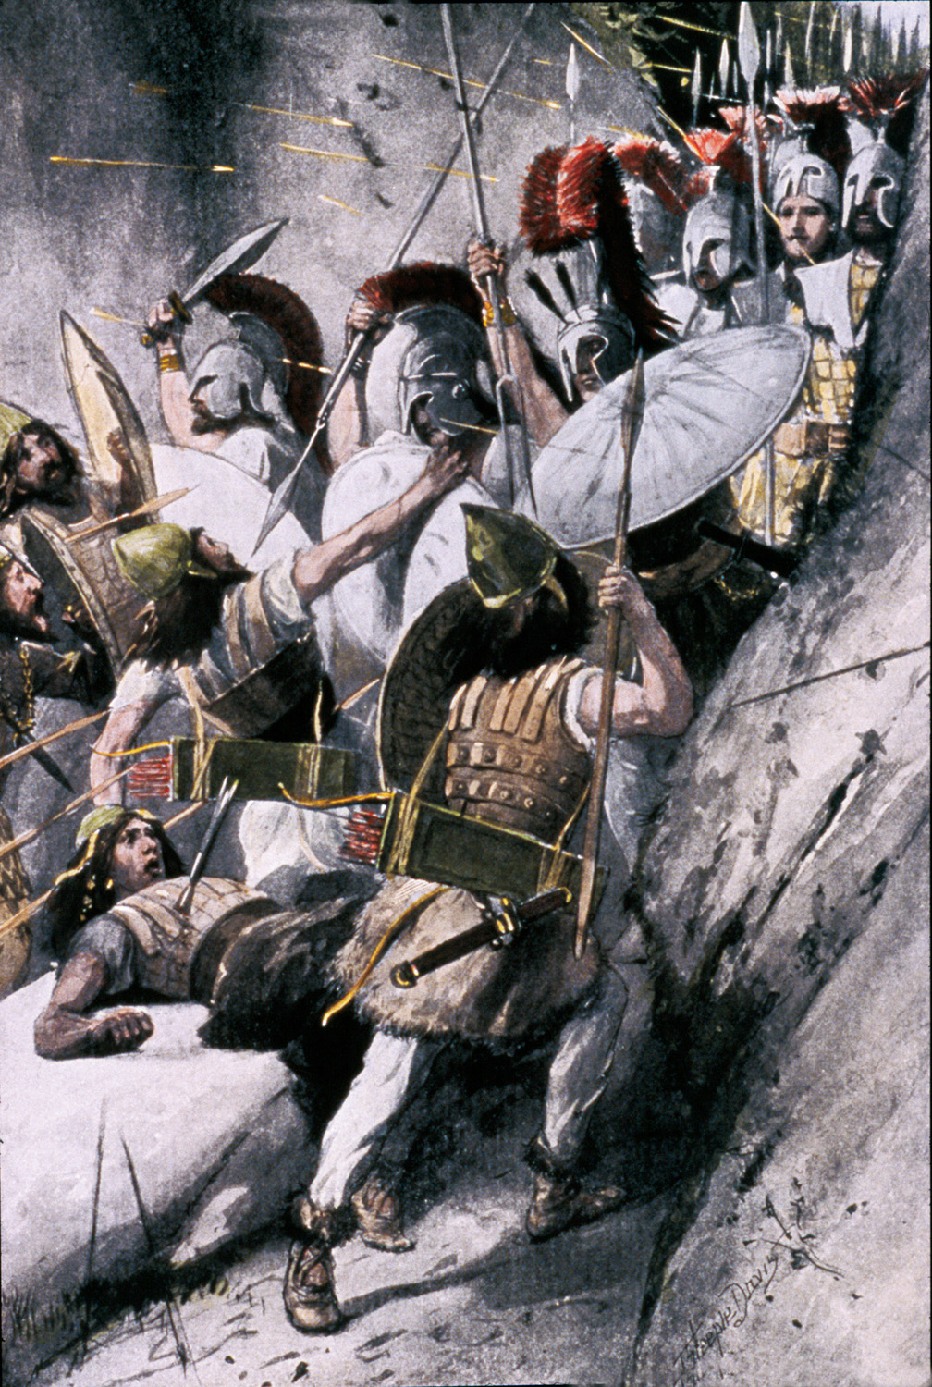
Battle of
Thermopylae-
August 480 BCE

Slide 23
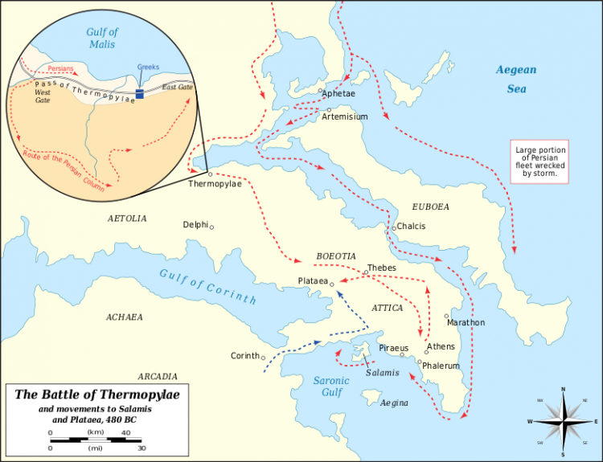

Slide 24
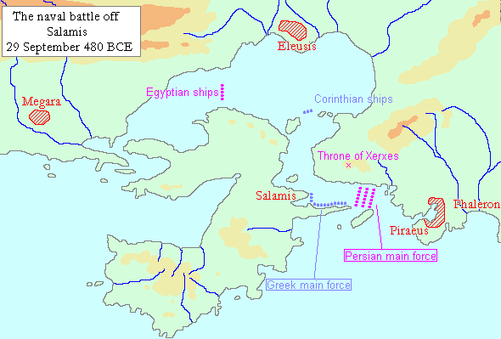

Slide 25
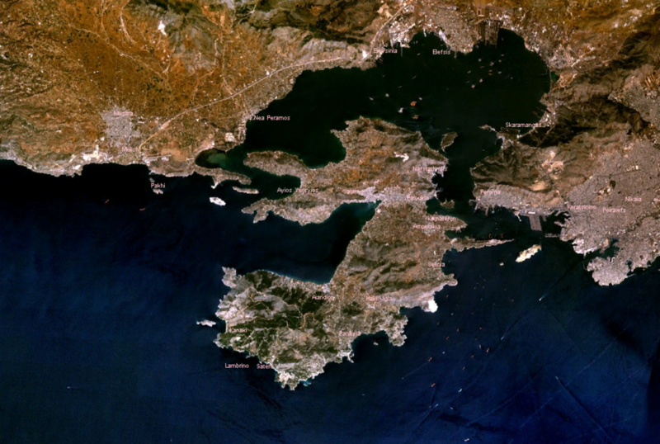
Battle of Salamis- September 480 BCE

Slide 26
Triremes
Boats of both Persians & Greeks
Strong bronze bows on sides of ships that were used as battering rams
3 rows of oarsmen powered the Greek and Persian ships

Slide 27
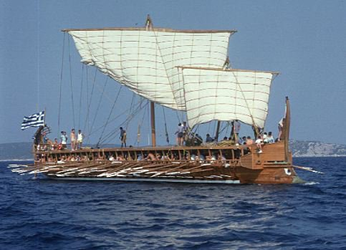

Slide 28
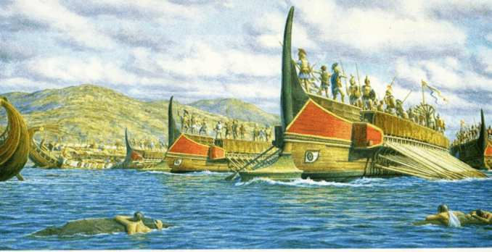

Slide 29
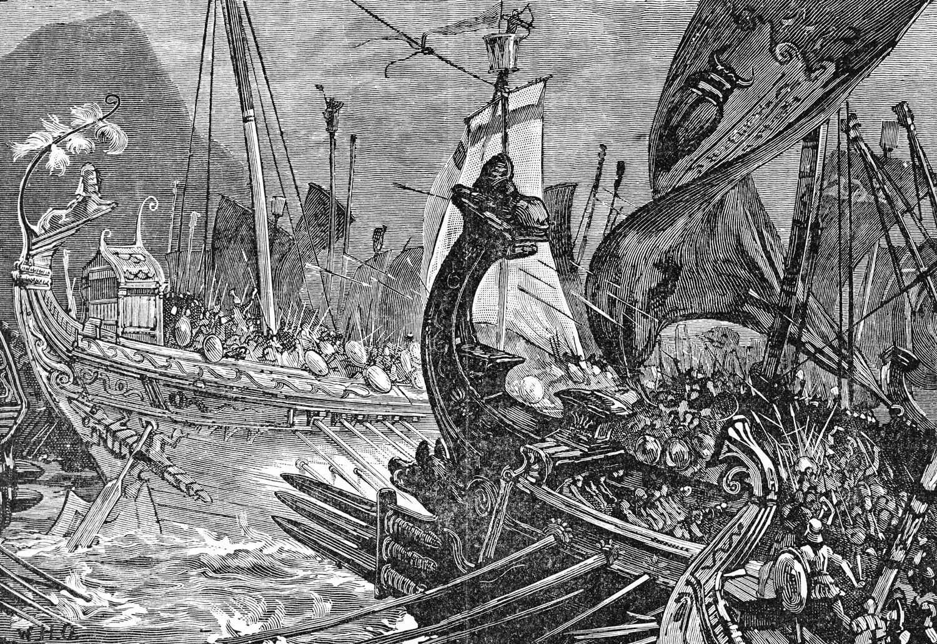

Slide 30
Aeschylus (525 BCE-456 BCE)
Soldier & playwright
Fought in Battle of Marathon & Battle of Plataea
The Persians
Loss of war blamed on hubris
Building a bridge across the Hellespont had angered the gods

Slide 31
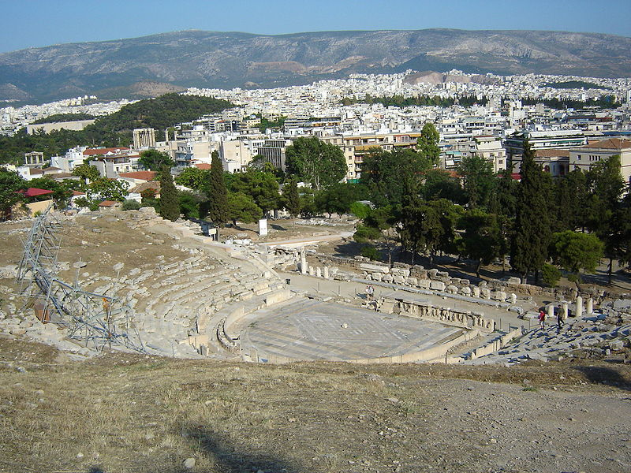

Slide 33
Battle of Plataea
August 479 BCE
Battle lasted for nearly 2 weeks
Some Greek city-states, most notably Thebes, had actually gone onto the Persian side by now
Spartans (about 5,000) led fighting
Total of about 80,000 Greek troops
Herodotus said there were 300,000 Persian troops there- this is doubtful, and the number was more likely somewhere between 70,000-120,000

Slide 34
Battle of Plataea- 479 BCE
Persians led by Xerxes’ brother-in-law, Mardonius (killed in battle)
80,000 Greeks, including Spartans and Athenians, destroyed what was left of the Persian army

Slide 35
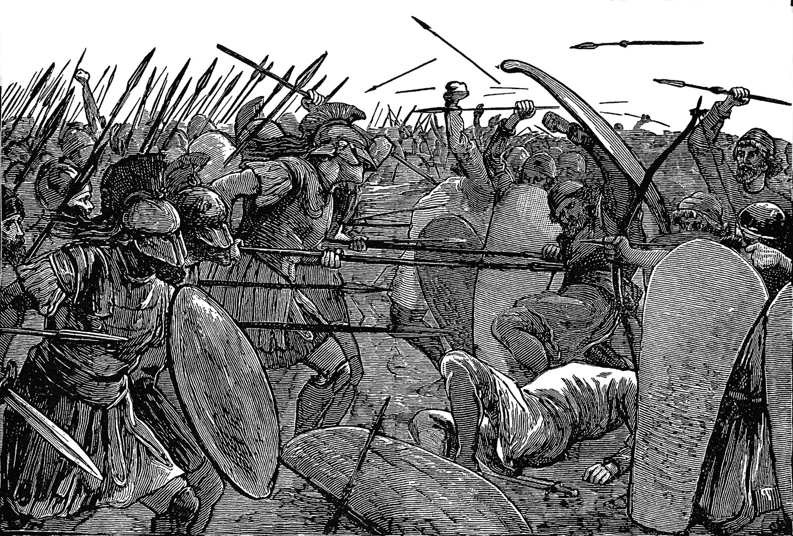

Slide 36
Outcomes of the Greco-Persian Wars
Independence of Greek City States is preserved
Persians do not take over Europe

Slide 37
Describe 1 of the 4 major battles of the Greco-Persian Wars. Include the location of the battle, when the battle occurred, who fought at each battle, any significant historical figures present, and what happened there. Also, please describe why the outcome of this battle was significant. Your responses should be at least 7 sentences in length. Also provide an “independent insight” at the end that shows you understand the significance of that battle to democracy or western civilization.

Slide 38
Test Format
Part I. Multiple Choice (25 Questions x 3 pts.)= 75 Points
Part II. Open Response (1 Question x 25 pts.)= 25 Points
Test Total- 100 Points

